Slide 1

COA STANDARDIZATION Working group Quarterly Face to Face Workshop
31 MAR 2016

Slide 2
3/31 Face to Face Workshop Agenda
Time | Topic | Presenter/Facilitator
8:30 - 8:40 | Introduction and Key Note | Neal Ziring, MPO
 | Reference Implementations
8:40 – 9:20 | OpenC2 in Pub-Sub Environment | Shawn Webb, G2
9:20 -10:20 | Software Defined Networks | Randy Sharo, SPAWAR
10:20 – 10:35 | OpenC2 and MIRA | Joe Brule, MPO
10:35 – 10:50 | Break
10:50 – 11:10 | Automated Defensive Actions | Jim Ronayne, Cyber Defense Research
11:10 – 1:00 | Open Discussion: Other Reference Implementations | Invotas, Phantom, All
 | Cyber Incident TTPs Response Actions
 | Includes Working Lunch
1:00 – 1:40 | OpenC2 and STIX Update | Jyoti Verma, Cisco
1:40 – 2:00 | OpenC2 External Dependencies | Joe Brule, MPO
2:00 – 3:50 | OpenC2 Security Requirements and Models | Pat Muoio, G2
3:50 – 4:00 | Wrap Up | All

Slide 3
Quarterly face to face workshop Spring 2016
Neal Ziring
NSA IAD Technical Director
31 MAR 2016

Slide 4
Agenda
Status
Background
Works in Progress
Way Forward
Define Profiles
Define External Dependencies
Path to Standards

Slide 5
The Motivation and Vision
Future Cyber Defense Tactics:
Sharing of indicators
Coordination of response actions
Automated, multi-part actions at machine speed
OpenC2 Forum
Identify and fill gaps as they pertain to command and control for the provision or support of cyberdefense
Create a diverse and collaborative environment.
Standardization is a Key Enabler for Unambiguous C2
Notes:
Highlight that the responses need to be coordinated and that standards based solutions will facilitate integration

Slide 6
Status
Kickoff July 29, 2015
~ 20 individuals representing eight organizations
March 31, 2016
~104 individuals representing 22 organizations
Office of General Council is providing ongoing support including the writing of:
Charter
ByLaws
Membership Agreement
Notes:
This might be a good slide to insert what you heard at RSA. BTW, this is not too bad for eight months!

Slide 7
Works in Progress
Draft Language Description Document
Define Syntax and Actions
Modular data model
Cybox objects for targets
OpenC2
Creation of STIX sub-working group
Creation of SDN Profile
Creation of Web Repository
Public facing website
Private Github for collaboration
Notes:
We converged on about 30 actions and are using the cybox objects to provide the data model for the targets. The data model for the actuators is still in process, for now using an OpenC2 defined model
CISCO is leading the effort to work with OASIS. Jyoti will give us an update later today
SPAWAR had done some remarkable work on an SDN overlay and Randy will provide an overview later this morning

Slide 8
Reference Implementations
Purpose
Exercise the language
Span multiple environments and Use Cases
Current Efforts
Perimeter Defense (pub-sub environment)
Isolate/ Redirect (SDN environment)
Inter-domain coordination (point to point environment)
Notes:
The definition of the use cases and work on the language itself is still in progress. The reference implementations will help us identify shortcomings and direct future efforts.
The current efforts will be presented and discussed through lunch today
We are currently working with NIST’s CCOE to provide use cases and requirements for OpenC2.

Slide 9
Next Steps
Refine language description document
Investigate/ define data models
Refine and expand reference implementations
Evaluate additional functionality
Define External Dependencies
Modify Language/ protocol
Investigate Security Requirements
Create IA Overlay
Notes:
This group has grown and matured enough to allow us to expand our efforts. The work on the language and the use cases will continue, but we need to identify additional functionality needed and determine which can be treated as external dependencies and where we need to expand the protocol.
The next ‘big’ effort will be the IA overlay.

Slide 10
Questions?

Slide 11
Reference Implementation
OpenC2 in Pub-Sub Environment

Slide 12
Reference Implementation
Software Defined Networks

Slide 13
Reference Implementation
OpenC2 and MIRA

Slide 14
Reference Implementation
Automating Defensive Actions

Slide 15
Automating Defensive Actions Reference Implementation
Project led by I4111, Cyber Defense Research & Technology
Built by JHU/APL
Started mid-March, end 30 September
Multiple spirals

Slide 16
Goals & Objectives
Focus on generation, sharing, ingestion, and execution of COAs
Gain a broad understanding of OpenC2 messages and dependencies
Validate the appropriate level of abstraction and syntax for COAs and responses
Provide an open source implementation that demonstrates interesting aspects of OpenC2
Provide feedback to the OpenC2 WG

Slide 17
Important Questions
What is the appropriate level of abstraction in COAs to achieve consistent effects across different environments?
What dependencies exist between technology, response actions, and desired effects? How do those dependencies affect message content?
Where should standardized messages end in a capability-based architecture to maintain flexibility and simplicity while still supporting the execution of consistent automated actions?
How do error conditions or incomplete execution impact the desired outcome and effectiveness of the COA?

Slide 18
Environment
Built in APL’s FIIRE (Federated Integrated Innovative Research Environment)
Simulate multiple enterprises, multiple locations
Multiple Orchestrators (Phantom, Invotas)
Multiple Actuators (HawkEye G, Carbon Black, Symantec, McAfee)
Build converters for existing tool APIs
Preference for host-based actions

Slide 19
Demonstrate
OpenC2 messages
Orchestrator to Orchestrator (within an enterprise)
Orchestrator to Actuator(s)
Use Cases
Mitigate DDOS
Defend against web drive-by download
Detecting botnet C2 channel
Configuration Taskord
Generic carrier (no STIX)

Slide 20
Reference Implementation
Open Discussion

Slide 21
Cyber Incident TTPs Response Actions
Jyoti Verma
Cisco
31 March 2016

Slide 22
External dependencies
Or ‘What is the next REALLY hard problem?’
Joe Brule
NSA IAD Active Cyber Defense
31 March 2016

Slide 23
Agenda
Tasks at Hand
Define within protocol
Create Overlay
Leave to Implementer
The Models & Environments
Design Principles
Next Steps?

Slide 24
External Dependencies and Considerations (Partial list)
Identifier (or UUID)
Connection management
Packet order
Missing packets
Latency management
Information Assurance Considerations
Authentication
Integrity
Confidentiality
Priority
TTL (i.e., duration that the command is valid)
Acknowledgement (receipt and/or execution of command)
Order of execution (for stream of commands)
Data Model for Targets, Sensors and Actuators
Should We Define as Overlay or Within Standard?

Slide 25
ACD Command and Control Model

Slide 26
Command and Control Model (examples)
Upper Tier to Lower Tier (hierarchical)
Peer to Peer
Enclave Level
Publish-Subscribe
Point to Point, unicast or multicast

Slide 27
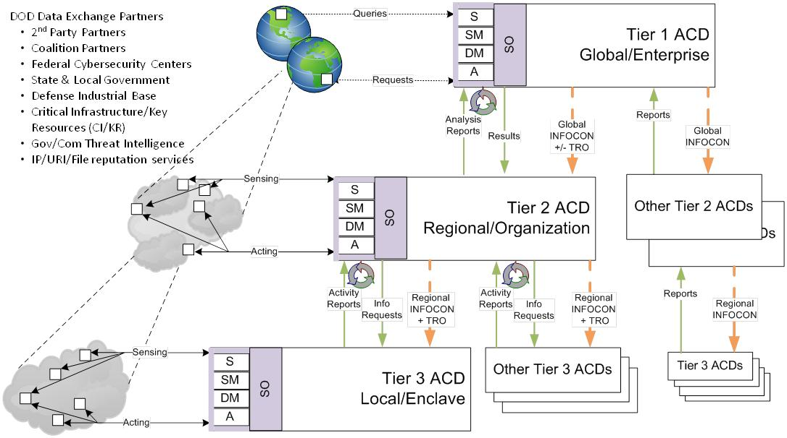
Hierarchical Model (an example)

Slide 28
Transport Model
Pub-Sub
Authentication/ Data at rest protection
Asynchronous
Acknowledgement
Missing packets
Jitter/ Delay
Full Mesh of https Sessions
Key Management
Full Mesh of PVC connections
Scalability concerns
Out of Band Command and Control Channel
Cost Concerns

Slide 29
OpenC2 Design Principles
Lightweight
Efficient Machine to Machine communications
Minimize the set of ‘core’ actions
Abstract
Focuses on ‘What’ to do vice ‘How’ to do it
Permits different levels of abstraction
Extensible
Address requirements for operational environment
Extensions enable additional precision and flexibility
Agnostic
Transport, Authentication, Integrity controls, etc.
Enables flexibility w.r.t. implementation
Enable Unambiguous Machine to Machine
Command and Control Messages
Notes:
The end state is to enable unambiguous messages for machine to machine C2.
The language needs to provide sufficient detail so that it is clear, but at a high enough level so it does not become obsolete or be device specific.
We want to accommodate different levels of abstraction so that we can convey the effects based commands across domains, but extensible so that we can provide context specific details to execute the tasks
We do not want to be bound by any particular protocols to ensure that the language will adapt to niche or future environments.

Slide 30
OpenC2 ‘Philosophy’
Pre-existing standards will be leveraged to the greatest extent practical
Minimize Complexity Of Command
Minimize Overhead on Sensor/Actuator
Infrastructure, architecture and vendor agnostic
Extensible to support different levels of detail and future technologies
Notes:
The end state is to enable unambiguous messages for machine to machine C2.
The language needs to provide sufficient detail so that it is clear, but at a high enough level so it does not become obsolete or be device specific.
We want to accommodate different levels of abstraction so that we can convey the effects based commands across domains, but extensible so that we can provide context specific details to execute the tasks
We do not want to be bound by any particular protocols to ensure that the language will adapt to niche or future environments.

Slide 31
Consideration: Acknowledgement
Inherit from Transport Layer
Simple to implement
Limited functionality/ flexibility
Define within header of Command
Can be optimized for C2 purposes
May introduce constraints
Concatenate Command
Introduces overhead only where needed
Introduces Language Requirements
Must not separate commands
Inhibits Asynchronous Execution of Commands

Slide 32
Consideration: Command Identifier/ Time to Live
Leverage RFC 4122 (UUID) ?
Does the ingress and egress define new commands?
[=] of TTL?
Milliseconds?
Hop count?
Create a header to manage TTL and Identifier?

Slide 33
Consideration: Connection Management
Connection Management
Packet order
Rely on Transport Layer or incorporate Command Count in the OpenC2 header?
Missing packets
Latency management
Priority
Is the entire C2 channel ‘Priority’?
Order of Execution
Asynchronous or Serial by Default?
Specify in frame or transfer Execution management to Orchestrator/ Decision Engine?

Slide 34
Revisit: Data Models
Current Strategy
Actions are defined by OpenC2
‘Plug in’ for Target and Actuator Data Models
Alternative Strategy
OpenC2 defined Data Model?
Define OpenC2 ‘Profiles’ from Existing Data Models
Cybox, ISCM, CDM, Others?
User specified Data Models

Slide 35
Information Assurance: The Next Hard Problem?
Availability
Define Minimum Specifications or leave to Owner?
Integrity
Inherit from Message Fabric or implement CRC?
Confidentiality
Do all links need Confidentiality?
Authentication
Explicitly Define or derive from C and I?
Mutual authentication?
Non Repudiation
Explicit or derive from Availability and Authentication?
Authorization
Define in the Language or Create IA Overlay?

Slide 36
Thank you! Questions?

Slide 37
Cyber Incident TTPs Response Actions
Olga Livingston

Slide 38
Open C2 and STIX

Slide 39
SECURITY REQUIREMENTS DISCUSSION COA STANDARDIZATION WG 17 March 2016
07 Jan 2016
COA Standardization Working Group

Slide 40
Toward a Security Model for OpenC2

Slide 41
Follow OpenC2 Design Principle
Universal core, specified in context
This is true for security model as well
Must satisfy certain key security requirements
How is left to the enterprise to define

Slide 42
What Does It Mean to Have Security Requirements for a Language?
Two Questions:
Does the language syntax need to change at all to accommodate high assurance use cases?
Does the security posture of the controlled system have an effect on the language?
This is not the same as addressing the security requirements for the system using the language or for any particular implementation.

Slide 43
Areas for Exploration
Integrity of message
Authentication and authorization of command issuer (human or machine)
Availability
Confidentiality
Non-repudiation
Other Areas (e.g., trust models, key management, software assurance)

Slide 44
Integrity of message
Assure message sent is message received
Protect against man-in-the-middle
Protect against replay
Provide non-repudiation

Slide 45
Integrity of message (2)
Minimum Requirement
Context-specific extensions
Changes must be detectable
Guard against “replay”
Message must convey validity (time)

Slide 46
Authentication and Authorization of Command Issuer
Assure commands are issued only by legitimate issuers
Assure issuers don’t overstep their authority
Accommodate multiple levels of authority
Assure executing nodes can validate commands
Do they also need to be authenticated?

Slide 47
Authentication and Authorization (2)
Minimum Requirements
Context-specific extensions
Validate command source (pov of actuator)
Issuer, not originator??
end-to-end authentication?

Slide 48
Other areas
Availability
Confidentiality
Non-repudiation
Trust models
Key management
Software assurance

